Slide 1
RTTY
RYRYRYRYRYRYRYRYRYRYRYRYRYRYRYRYRYRYRYRYRYRY
Software and Mechanical radio Teletype Operation
Daniel D. Jones (K6YIC) djones@k6yic.com
Notes:
About me, Navy Elmers (Bryan Wollenberg N3FAA pushed me to get my license after watching him do it since 1994) (NF6X Mark Blair I procured my M28 from him and he nursed me along until I was able to make a QSO with the MRCG Net) (K4NYW Nick England my main source of information on building vintage Navy Equipment)

Slide 2
Scope of Presentation
What is Radio Teletype
How to Identify Signals and Where Can you find them?
Baud, Frequency Shift and Inverted Signals
What equipment is needed
Vintage Equipment Demonstration
  Model 28 KSR
  TT-192a Reperforator
  TT-187 Transmitter Distributor
Modern Software Demonstration
  FLDigi
  Multimode
Questions

Slide 3
What is Radio Teletype
As stated by Wikipedia in its simplest form;
  Radioteletype (RTTY) is a telecommunications system consisting originally of two or more electromechanical teleprinters in different locations connected by radio rather than a wired link.
    Radio Automatic Teletype (RATT) is the military term to describe the same thing.
  Emile Baudot created the 5 level code in 1874 that is still in use today.
  The United States Navy first used Radio Teletype in 1922 with communication established from an airplane to a ground station.
  Radio Teletype and Teletype equipment was only phased out as main communication method in the 1980s as the more modern computers became cheaper and easier to implement. HF communications gave way as Satellite became the primary source of commercial and military communications.

Slide 4

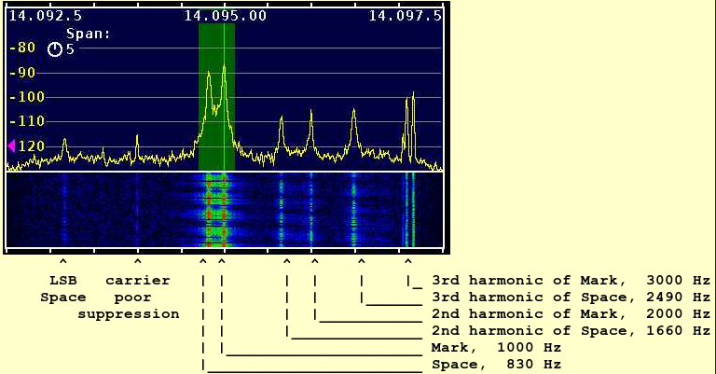
How to Identify RTTY Signals

Slide 5


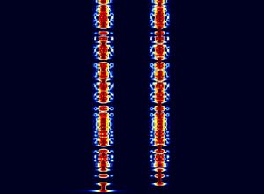
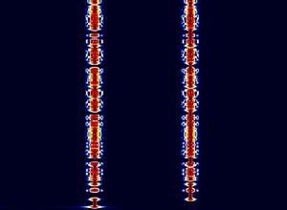
Another Example
85Hz Shift
170Hz Shift
450Hz Shift
850Hz Shift

Slide 6
What it sounds like…
45.45 Baud 850hz (Vintage Military Standard)
  https://www.sigidwiki.com/images/2/2f/RTTY_850Hz_45.45Bd.mp3
45.45 Baud 170hz (Most Commonly used)
  https://www.sigidwiki.com/images/3/3a/RTTY_170Hz_45.45Bd.mp3

Slide 7
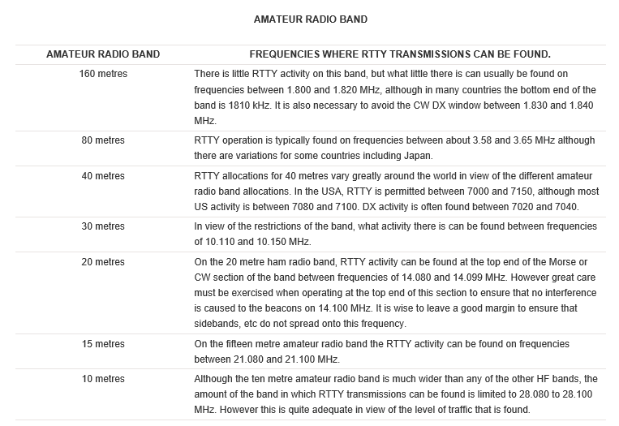
Where can you find Signals?
https://www.electronics-notes.com/articles/ham_radio/digimodes/amateur-rtty-frequencies.php
MRCG Clatternet (Currently Saturdays 2300Z @ 7087mhz USB 850hz Shift)
Notes:
40, 20, 10 find between 080 and 100

Slide 8
Shift, Frequency and Baud
Shift is the band spread between the Mark and the Space tones, Smaller the shift the less Bandwidth is required. While 170 is most common there is no reason you can’t use other shifts.
  Amateur radio use is 170hz
  Military Commercial use 850hz
Audio Frequency Shift Keying (AFSK) most commonly used currently, if you are using FLDigi, MMTY or Multimode don’t need to use the radios FSK/RTTY function. AFSK is one of the simplest ways to get on using RTTY.
  The standard tones used are 2125hz and 2295hz for Amateur 170hz use
  The Standard Military tones are 1575hz and 2425hz for 850hz shift
Baud is the speed the signal changes per second
  Amateur is almost always 45.45 Baud (60WPM)
  Military and Commercial commonly used 50, 75 Baud (66, 100 WPM)
Notes:
Now shift and Audio Tone Frequencies are not as critical as software RTTY programs can adapt to most anything as a common shift is used (170, 425, 850 ect...)

Slide 9
What Equipment is Needed? (Software)
Personal Computer (Mac or PC)
A radio capable of transmitting at a higher Duty Cycle
  Most radios built from the 1990s on have some sort of way to connect to a computer via RS-232, USB or with a digital adapter such as a signalink.
Software
  FLDigi (Both Mac and PC Versions)
  MMTTY (PC only Version)
  MultiMode (Mac only Version)

Slide 10
What Equipment is needed (Hardware)
Teletype Machine
  Model 28 as well as 15, 19, 26s plus more were used by Amateurs over the years
Loop Supply (Some Terminal Units include this)
  These can be made from original Teletype or Military units or more modern supplies like the HP6634 or HP6407 DC Supplies. 120v 60ma or 20ma DC output.
Terminal unit (Converter, Modulator/Demodulator)
  Military options like CV89, CV-2460, CV3510 have limited capabilities but are well built units that current software and radios can still tune. (200hz, 850hz shift)
  Many 170hz shift Terminal units by companies like HAL, Flesure, Kantronics. These usually include built in loop supply.
Cables to connect Audio in/out and transmitter keying.

Slide 11
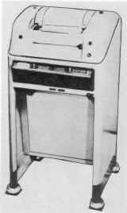
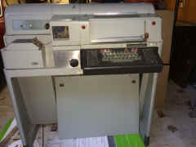
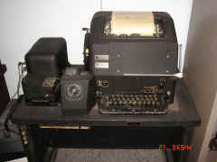
What Equipment is needed (Teletype)
Model 28 RO
Model 28 ASR
Model 19

Slide 12

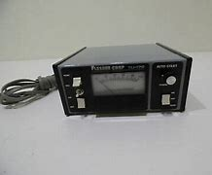
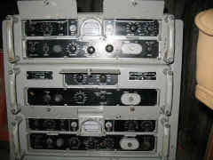
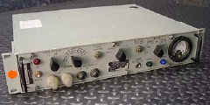
What Equipment is needed (Terminal Units)
Consumer Dovetron
Consumer Flesher TU-170
Military URA-8B
Other companies include HAL Kantronics and others
Military CV-2460
Notes:
Dovetron and Hal were both contractors for the military.
The 2460 was used for only transmitting in the Navy but was capable of receiving also. The receive side is not as sensitive as that of the 483 or 3510 which is why those models were used for receiving. (3510 was capable of TX also)

Slide 13
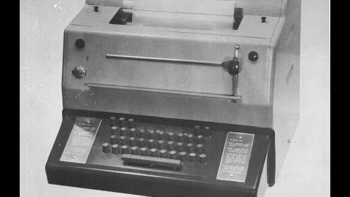
Vintage Equipment Demonstration
Model 28 (TT-307/UG) KSR
(Clatternet with MRCG West)
Notes:
This was the first time that I was able to complete an RTTY QSO with another station using mechanical teletype.
I had numerous issues mostly related to over driving the output on the Kenwood and Under driving the input on the 2460.

Slide 14
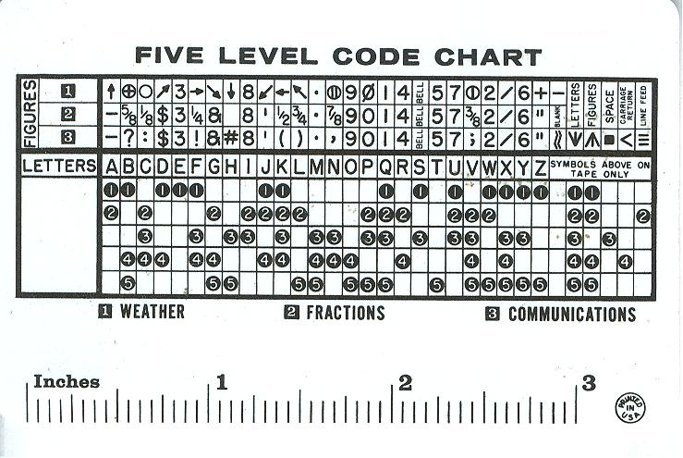
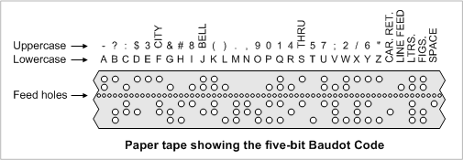
Decoding RTTY
Notes:
When reading punch tape you can decipher the print.
Some who have been doing TTY for long periods can probably pull key words out of the audio signal (I have read this but no one has actually been able to prove it to me)

Slide 15
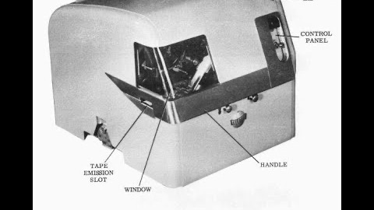
Vintage Equipment Demonstration
TT-192a Typing Reperforator Slow Motion
Notes:
I made this video to show what the machine does while running at 60wpm. (It is capable of running at 100wpm)
The mechanical action to produce the required tape is amazing.
These models suffer from print hammers falling apart due to age (This unit is also in ASR and other models)
If you know someone that needs the hammers let me know I have a firm that has created them on a 3D Printer. Each hammer is $11.00 (includes shipping) or 2 for $20.

Slide 16
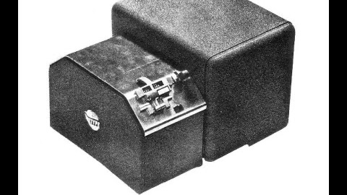
Vintage Equipment Demonstration
TT-187a Miniature Transmitter Distributor
Notes:
Just your average TD

Slide 17
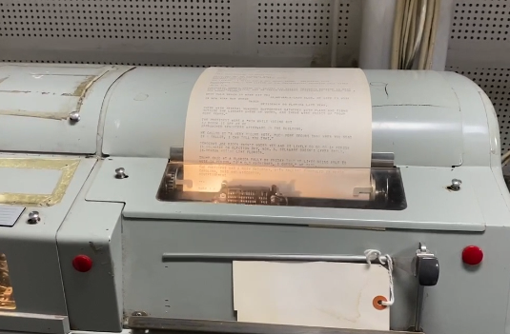
Teletype Model 28 ASR
USS Iowa BB-61
Printing ITTY News Feed.
Click on image to view video
Notes:
ASR #2 on USS Iowa BB-61. This is feeding the news from the Internet TTY feed.

Slide 18
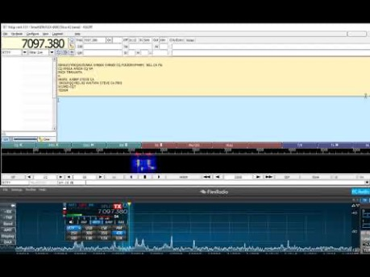
Software Demonstration (FLDigi)
FLDigi Download
MMTTY Download
MultiMode Download
Notes:
This is a demonstration of FLDigi taken from youtube. This is not my setup but gives an idea of the ease of getting on and using RTTY.

Slide 19
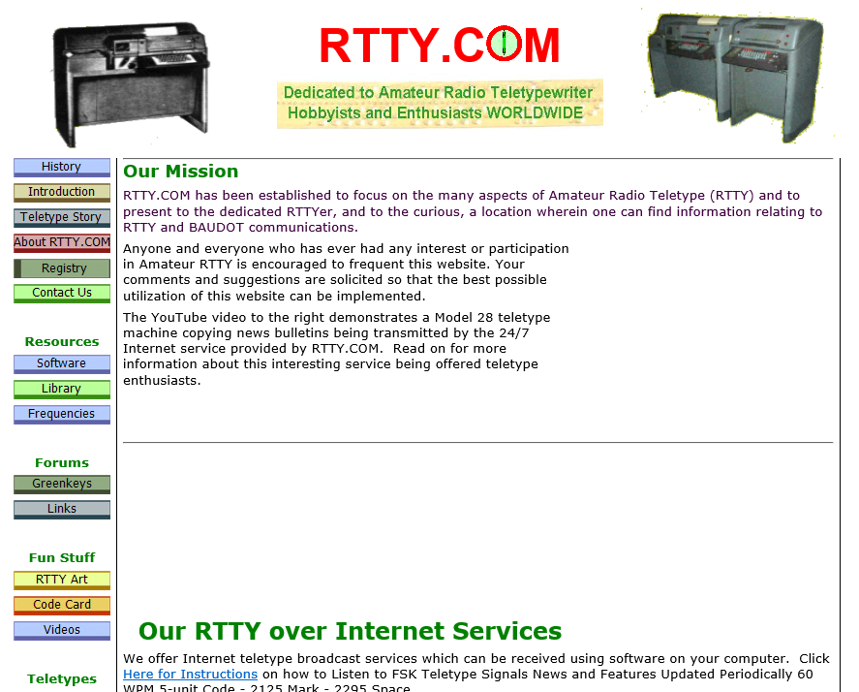
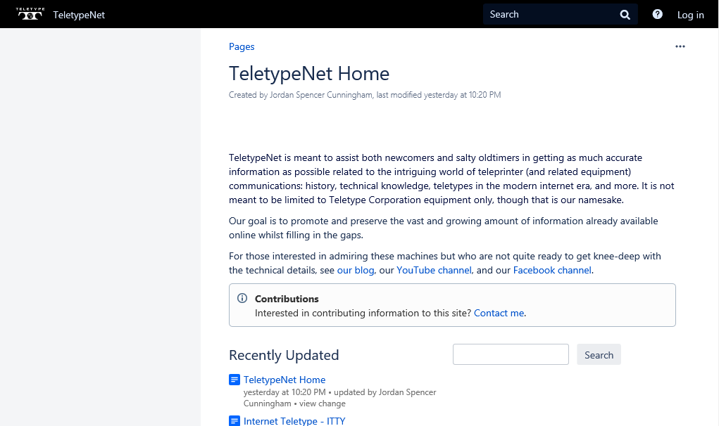
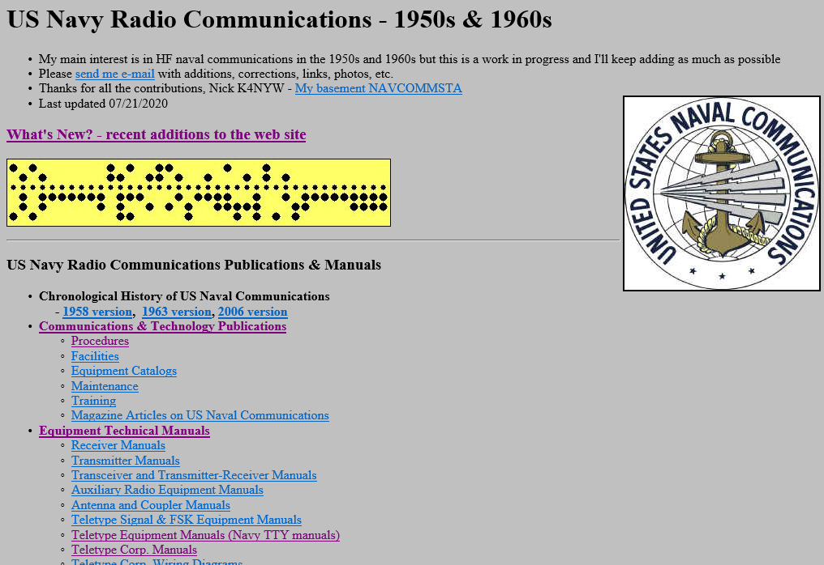
Further Reading and Information
RTTY.com
Navy-Radio.com
Teletype.net

Slide 20
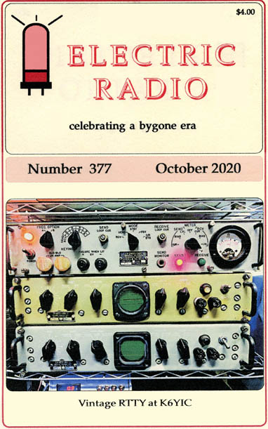
Plug for Electric Radio Magazine
Excellent source for vintage radio collectors. Includes articles on AM/SSB and vintage ham equipment.
I write articles on RTTY and Teletype for electric radio magazine.
If you do subscribe please let them know I sent you.
http://ERMag.com

Slide 21
NNNNN

